Slide 1
3rd INTERNATIONAL CONFERENCE ON MODERN MATHEMATICAL METHODS
FOR HIGH-PERFORMANCE COMPUTING IN
SCIENCE AND TECHNOLOGY
ON THE RECOMMENDATIONS FOR REDUCING CPU TIME OF MULTI-GRID PRECONDITIONED GUASS-SEIDEL METHOD
Presented by:
Abdul Hannan Faruqi
B.TECH. (FINAL YEAR)
DEPARTMENT OF MECHANICAL ENGINEERING
ZHCET, AMU
Co-Authors:
M Hamid Siddique¹, Abdus Samad², Syed Fahad Anwar³
1 Department of Mechanical Engineering, ADCET, Ashta, Maharashtra-416301, India.
2 Department of Ocean Engineering, IIT Madras, Adyar, Chennai, Tamil Nadu- 600036 India.
3 Computational Aerodynamics Lab, Department of Mechanical Engineering, ZHCET, AMU Aligarh.

Slide 2
Motivation for Multigrid
Propagation of boundary conditions (temperature) towards the inside

Slide 3
Motivation for Multigrid
Plain Gauss-Seidel
With Multigrid pre-conditioner

Slide 4
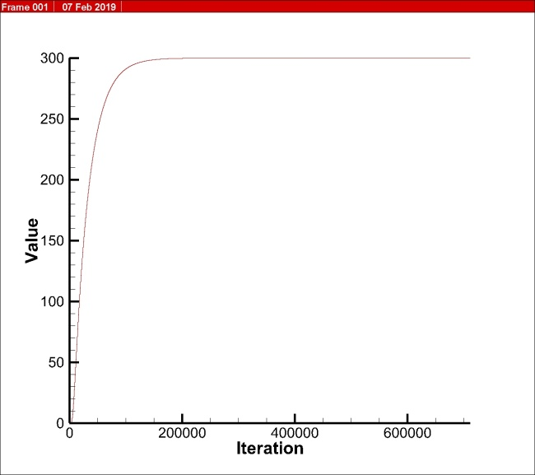
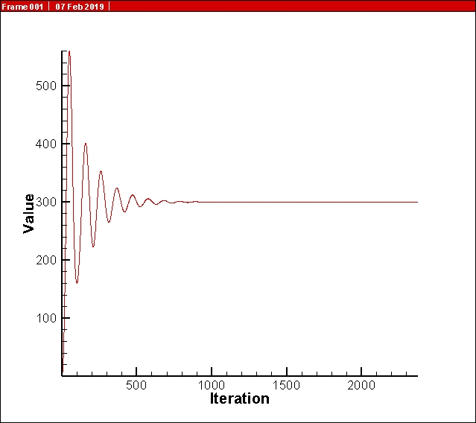
Solution comparison
Gauss - Seidel
Multigrid pre-conditioned Gauss-Seidel

Slide 5
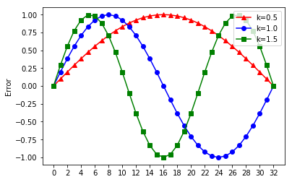
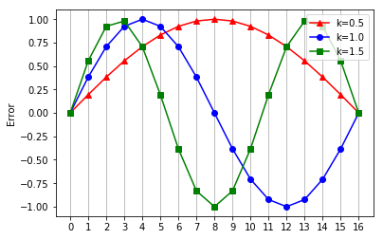
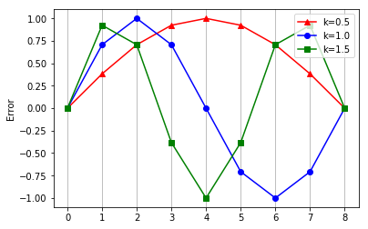
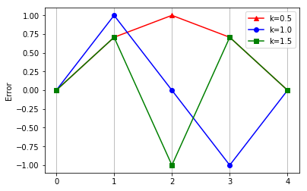
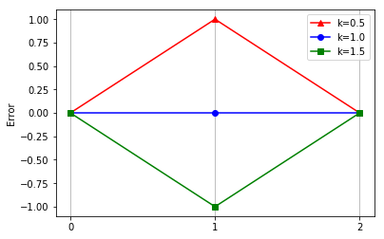
Multigrid Methodology
Fine grid error distribution
Level 0
Level 1
Level 2
Level 3
Level 4

Slide 6
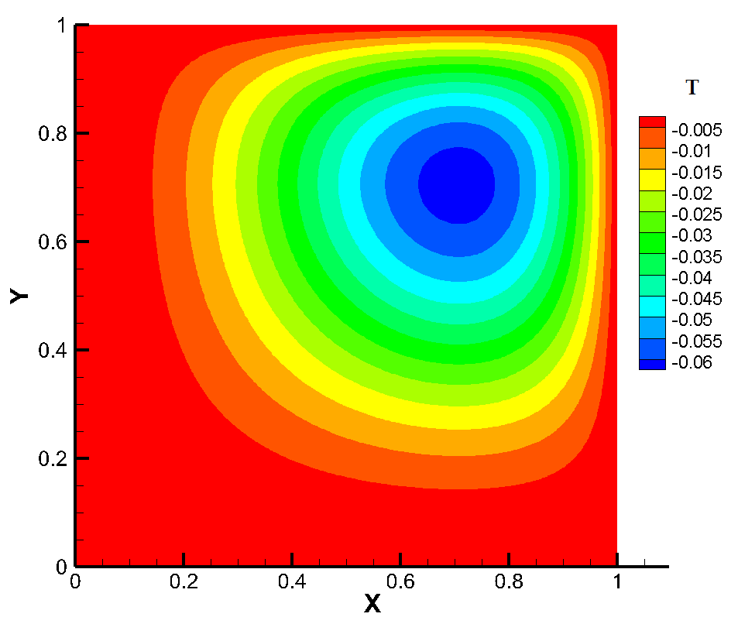

The Test Problem
Analytical Solution
Numerical solution

Slide 7
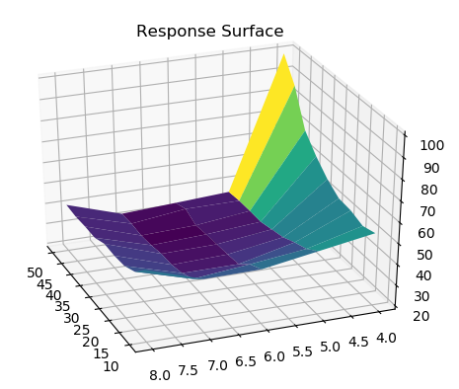
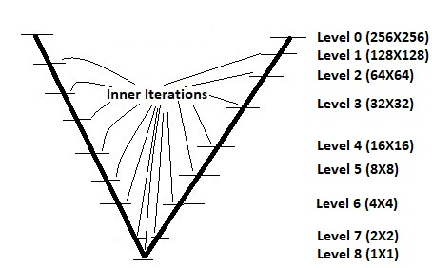
The V - cycle

Slide 8
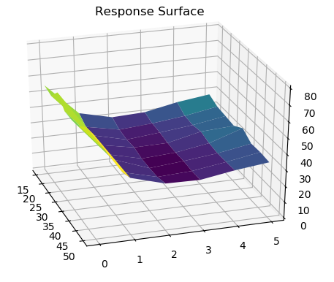
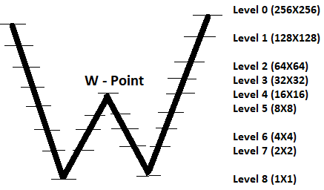
The W - cycle

Slide 9
Defining the Domain
Methodology to restrict the domain for unconstrained optimisation
Effect of no. of levels
Effect of no. of inner iterations

Slide 10
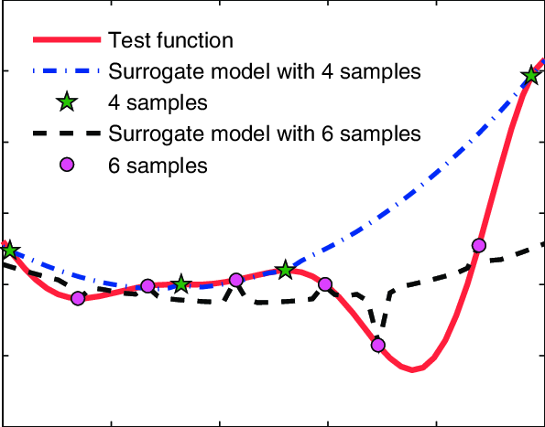
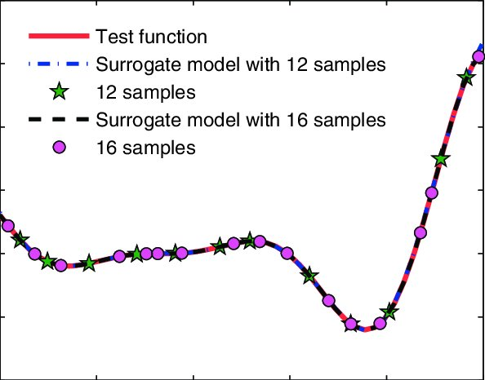
Surrogate Modelling
Surrogate models are low-fidelity regression models constructed using data drawn from high-fidelity models. These models can generate thousands of approximate results from a few samples, thereby simplifying the process of finding the optimal solution.
Image source: Xu, Q. & Wehrle, Erich & Baier, H.. (2012). Optimization. 61. 1-24.10.1080/02331934.2011.644286

Slide 11
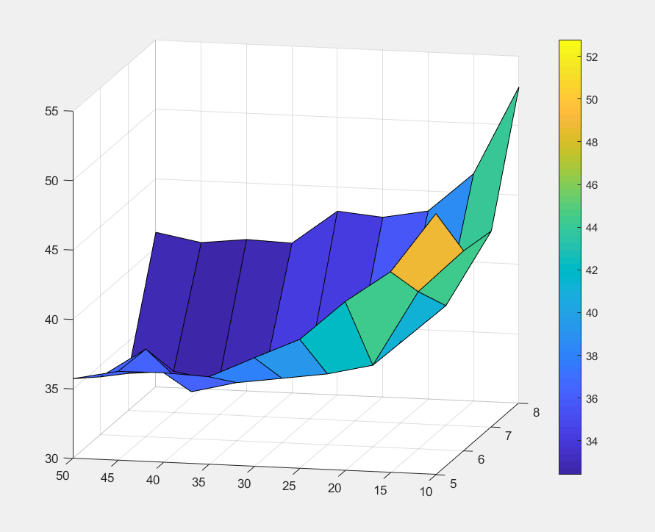
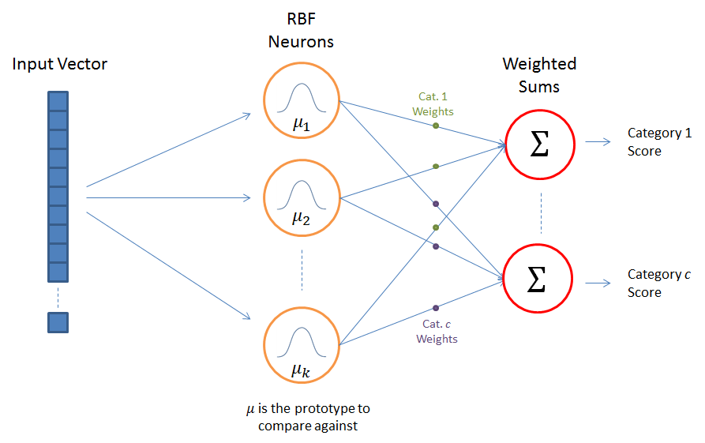
Optimization
Surrogate modelling
Techniques:
Response surface approximation
Kriging Model
Radial Basis Neural Network
Response surface for 2-D design space (single V cycle)
Weighted average surrogate (WAS)
Assignment of weights:
A radial basis neural network
Source: Radial Basis Function Network (RBFN) Tutorial
Chris McCormick
.

Slide 12
Results
Inference:
W cycle optimal
Single W cycle – preferred
Grid levels : 0-7-2-7-0
Inner iterations = 36
Cycle | Parameters |  |  | Optimal value of objective function (CPU time) from surrogate model | Actual value at the suggested point
 | Levels | Inner Iterations | W -point
Single V cycle | 7 | 47 | - | 31.06 | 32.44
Double V cycle | 6 | 39 | - | 33.3 | 36
Single W cycle | 7 | 36 | 2 | 26.3 | 25.68
Double W cycle | 7 | 28 | 2 | 27 | 27

Slide 13
References
Achi Brandt (April 1977), "Multi-Level Adaptive Solutions to Boundary-Value Problems", Mathematics of Computation, 31: 333–90.
Jameson A. (1986) Multigrid algorithms for compressible flow calculations. In: Hackbusch W., Trottenberg U. (eds) Multigrid Methods II. Lecture Notes in Mathematics, vol 1228. Springer, Berlin, Heidelberg
Stüben, K.. (2001). A review of algebraic multigrid. Journal of Computational and Applied Mathematics. 128. 281-309. 10.1016/S0377-0427(00)00516-1.
S. Vakili and M. Darbandi, Recommendations on Enhancing the Efficiency of Algebraic Multigrid Preconditioned GMRES in solving Coupled Fluid Flow Equation, Numerical Heat Transfer,Part B, Fundamentals,55:3,232−256, 2009.
Nestor V. Queipo , Raphael T. Haftka, Wei Shyy, Tushar Goel, Raj Vaidyanathan, P. Kevin Tucker, Surrogate-based Analysis and Optimization, NASA, 2005
M. Hamid Siddique, Arshad Afzal , Abdus Samad , Design Optimization of the Centrifugal Pumps via Low Fidelity Models, Hindawi, Mathematical Problems in Engineering, 3987594, 2018.
Goel, Tushar & Haftka, Raphael & Shyy, Wei & Queipo, Nestor. (2007). Ensemble of surrogates. Structural and Multidisciplinary Optimization. 33. 199-216. 10.1007/s00158-006-0051-9.
Apostol Poceski, A variational approach in the finite element method, Computers & Structures, Volume 33, Issue 2, 1989, Pages 395-402, ISSN 0045-794
R. Suero, M.A.V. Pinto, C.H. Marchi, L.K. Araki, A.C. Alves, Analysis of Algebraic Multigrid Parameters for two-Dimensional Steady State Heat Diffusion Equations, Applied Mathematical Modeling, 36, 2996−3006, 2012.
Stüben K., Trottenberg U. (1982) Multigrid methods: Fundamental algorithms, model problem analysis and applications. In: Hackbusch W., Trottenberg U. (eds) Multigrid Methods. Lecture Notes in Mathematics, vol 960. Springer, Berlin, Heidelber

Slide 14

THANK YOU
Abdul Hannan Faruqi
This work is licensed under the Creative Commons Attribution-NonCommercial-ShareAlike 4.0 International License.
To view a copy of this license, visit http://creativecommons.org/licenses/by-nc-sa/4.0/.

